Slide 1


DRIVER ALERTNESS SYSTEM & smart traffic management

Slide 2
Problem Description
A lot of deaths are happening because of road accidents. So, to prevent these accidents, a driver alertness system must be made.
Deaths due to accidents:
There is one death every four minutes due to a road accident in India. In India, more than 150,000 people are killed each year in traffic accidents. That’s about 400 fatalities a day
Cost of Accidents:
3% of GDP (RS. 3.8 LAKH CR)
SOURCE: MRTH, GOI & NCRB,MoRTH

Slide 3
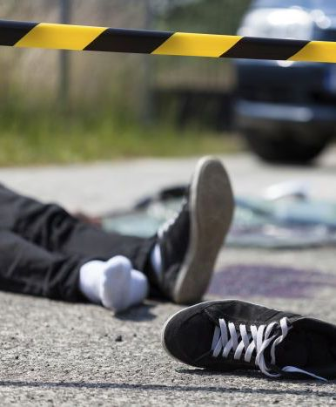



MAJOR CAUSES
DRUNK DRIVING
DROWSY DRIVING
OVER-SPEEDING
Alcohol and drug influence caused 3.7% of Road Accidents and 5.1% of deaths.
Sleepiness Fatigue and Distraction caused about 5000 of Road Accidents and 2000 of deaths.
Speeding Reasons were involved in over 66.5% of Road Accidents and 61% of deaths.
WE NEED TO FIND OUT A SOLUTION FOR THE FOLLOWING FACTOR CAUSES OF ACCIDENTS:
SOURCE: MRTH, GOI & NCRB,MoRTH

Slide 4
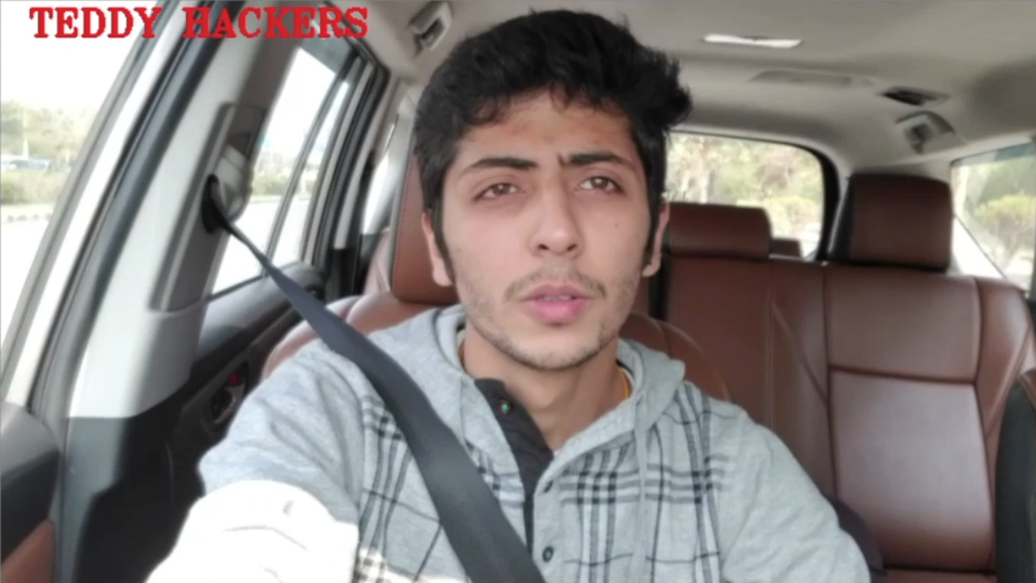
Feature : Detecting Drowsiness and Distraction
Demonstration Video:

Slide 5
Show-stoppers:
How we incorporated more features based on practical demand -
Calibration
Detected Talking
Disabling Face Tilt on Curve
To adjust the system be able to use by different people with different facial features.
It takes 5 seconds at the start to calibrate to a particular user to take note of his normal state.
When Variation of the mouth ratio was observed within a range.
Since talking on phone and to others, both are a cause of distraction.
The system disable distraction face tilt warning on Road curves.
It picks the indicator signal and diables the face tilt warning for that direction.

Slide 6
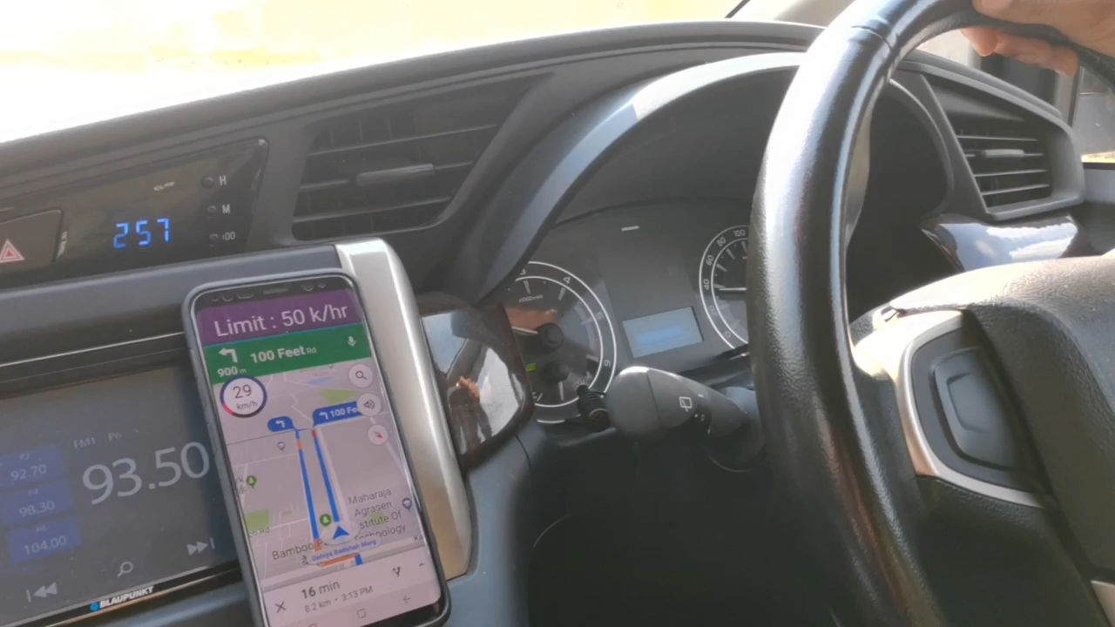
Feature : Overspeed Warning in Action
Demonstration Video:

Slide 7

Feature : Collision Prevention Alert
Demonstration Video:

Slide 8
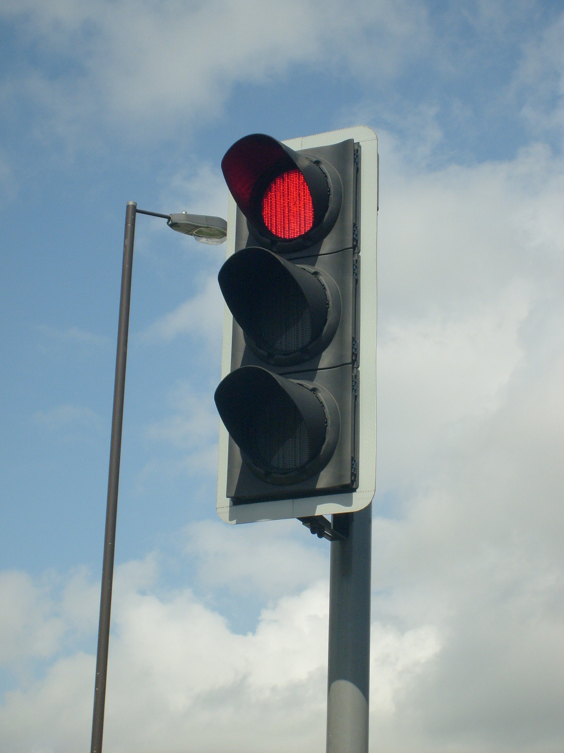




Unique
Impact
Solution to all possible angles Integrated at one place using Machine Learning, IoT, Deep Learning.
Hassle free green corridor for emergency vehicles, Reduce unnecessary stopping which in turn reduces fuel consumption
INTELLIGENT TRAFFIC CONTROL SYSTEMS
A development of an intelligent traffic signal control (ITSC) system needed because present traffic light controllers. These systems have limitation because they will use the predefined program that does not have the flexibility of modification on real time application.
A system which gives highest priority to emergency vehicles like fire trucks, ambulances etc.
A system which can increase traffic handling capacity of roads.
User Experience
Scalability
High user engagement rate by using techniques like internationalization, and easy alerts, less restrictions without compromise on security.
Completely scalable solution based on present scenario

Slide 9
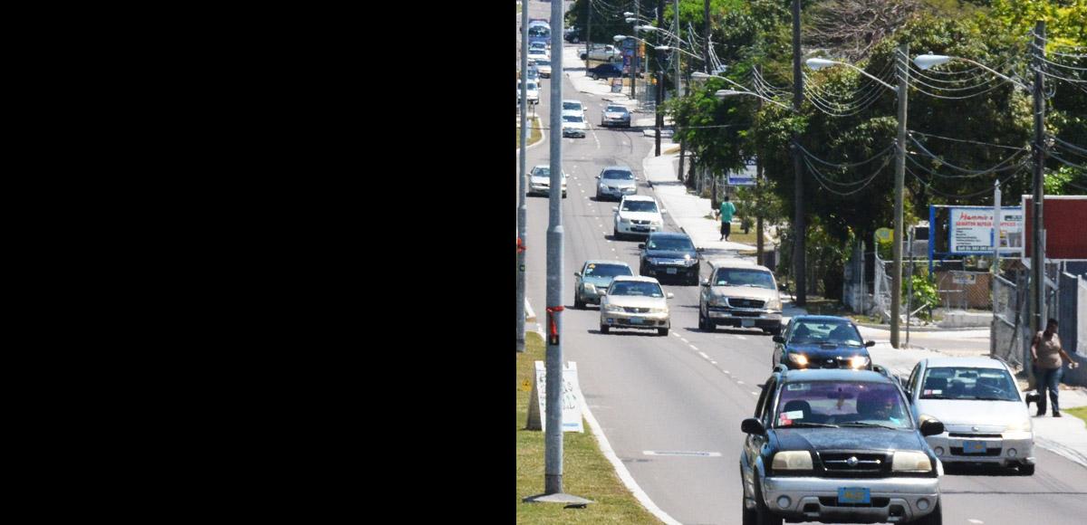
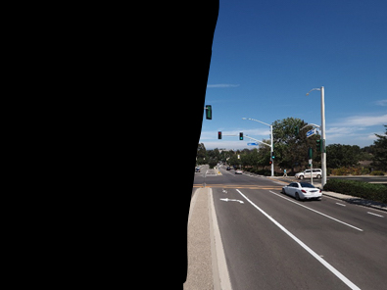
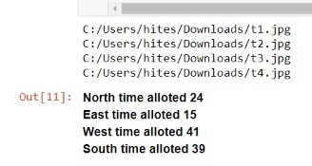
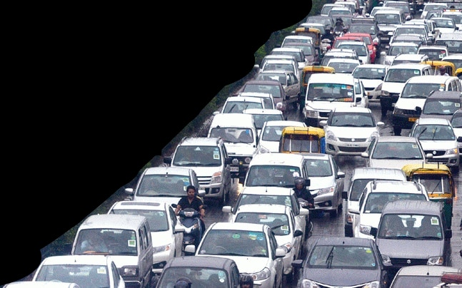
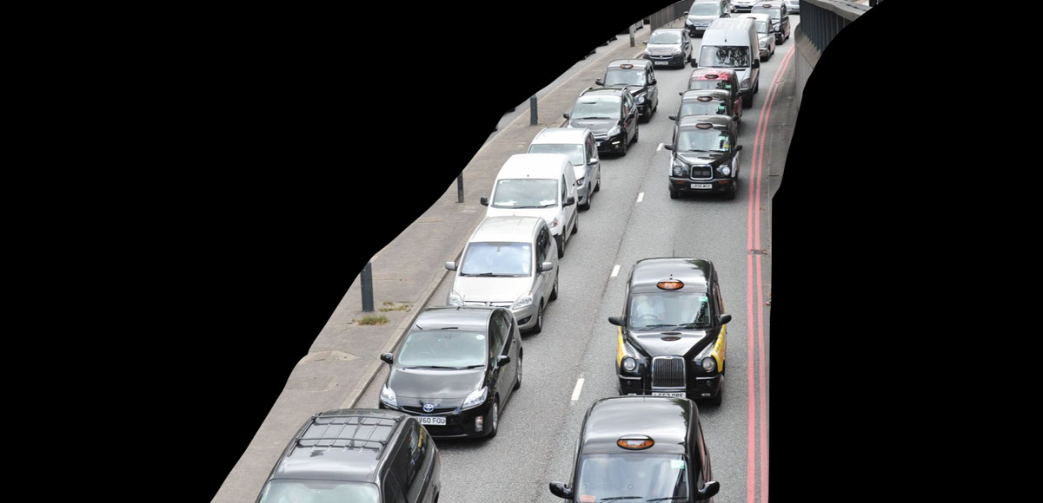
Feature : Intelligent Traffic control system(ITCS)
Tech Implementation
Traffic Detection:
Calculating Green Signal Time
Boundary detection of vehicles by a computer vision algorithm using Tensorflow.
Assigned different weightage to different vehicles; thus getting the traffic density of all the direction of cross-roads or intersections.
Optimising the periodic green signal time.
Based on the traffic densities which we got from traffic detection we asssigned the green signal time as per the weightage ratio.

Slide 10
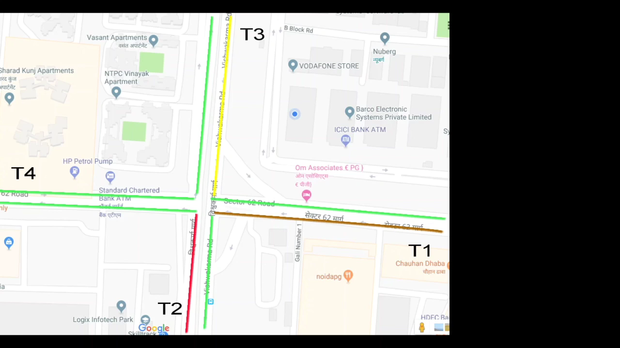
Feature : Smart Traffic Management System
Demonstration Video:

Slide 11





Conclusion and Further Plans:
Optimal use of resources
All Integrated in One System
Business Importance
High Security and Performance
Unique Solution – Of Critical Importance
Our system use requires minimal computation with real time results on low cost hardware.
All above features are fully implemented with working Demo and can be easily accessed by all through an engaging UI.
High Business value as solution can be marketed both B2B and B2C.
Made affordable and feasible with High impact especially in India Market.
Immense Deaths and Loss , are of critical importance to the country and ministry. This can practically save lives of 1,50,000 people yearly in India itself.

